Slide 1
Video Programming
Jalal Kawash

Slide 2
Outline
2D arrays
Memory-mapped I/O
Mailboxes
Frame buffer architecture
Drawing basic shapes

Slide 3
2D Arrays
Section 1

Slide 4
Section 1 Objectives At the end of this section you will
Map 2D arrays to 1D arrays
Work with row-major and column-major organizations

Slide 5
2D Arrays
Two-dimensional arrays must be mapped onto 1D memory
Can use row-major ordering
Store each element of row 0, then row 1, etc.
Used in most high-level languages, including C, C++
Or column-major ordering
Store each element of column 0, then column 1, etc.
Used by FORTRAN

Slide 6
Example
Logical arrangement:
10 | 20 | 30
40 | 50 | 60
Mapping in row-major order:
10 | 20 | 30 | 40 | 50 | 60
Mapping in column-major order:
10 | 40 | 20 | 50 | 30 | 60

Slide 7
Indexing 2D Arrays
The indices for a multidimensional array must be converted into an offset
Added to array starting address
For a 2D array list[1..n][1..m], row-major order, list[i][j] is:
((m * i) + j) ⋅ E_{size}
E_{size} is the element (cell) size in bytes

Slide 8
Indexing 2D Arrays
Example C Code declaration of
char array[2][3]
array[1][2] maps to an offset of
(3 * 1 + 2) * 1 = 5
((m * i) + j) ⋅ E_{size}
0,0 | 0,1 | 0,2
1,0 | 1,1 | 1,2
0 | 1 | 2
3 | 4 | 5
Logical view
Physical view

Slide 9
Indexing 2D Arrays
Example Java Code declaration of
char[2][3] array
array[1][2] maps to an offset of
(3 * 1 + 2) * 2 = 10
((m * i) + j) ⋅ E_{size}
0,0 | 0,1 | 0,2
1,0 | 1,1 | 1,2
0 | 2 | 4
6 | 8 | 10
Logical view
Physical view

Slide 10
Effective Addresses
A 1D array cell is accessed by:
base + offset
base is the starting address of the array
offset = (cell number) * (cell size in bytes)

Slide 11
In C
10 | 20 | 30 | 40 | 50 | 60
a
p
int a[6] = {10, 20, 30, 40, 50, 60};
int *p;
int b;
a[3] = 5; // assign element 3 of a
p = a; // p refers to elements of a
*(p+3) = 5; // does the same assignment
b = a[5]; // assign b value of a[5] – 60
b = *(p+4); // assign b value of a[4] – 50

Slide 12
In C
12
10 | 20 | 30 | 40 | 50 | 60
a
p
int a[6] = {10, 20, 30, 40, 50, 60};
int nr = 2, nc = 3; // nr rows, nc columns
int *p;
int b;
a[1 * nc + 2] = 5; // assigns a[1,2]
p = a; // p refers to elements of a
*(p+1*nc+2) = 5; // does the same assignment
b = a[0*nc+2]; // assign b value of a[0,2] – 30
b = *(p+4); // assign b value of a[4] – 50

Slide 13
Examples
myArray: .word 10, 20, 30, 40, 50
Cell containing 10 has address
myArray + o*4
Cell containing 20 has address
myArray + 1*4
Cell containing 30 has address
myArray + 2*4

Slide 14
Examples
myArray: .byte 10, 20, 30, 40, 50
Cell containing 10 has address
myArray + o*1
Cell containing 20 has address
myArray + 1*1
Cell containing 30 has address
myArray + 2*1

Slide 15
Memory-Mapped I/O
Section 2

Slide 16
Section 2 Objectives At the end of this section you will
Understand memory-mapped I/O
Know how frame-buffers are organized

Slide 17
Memory-Mapped I/O
A method for performing I/O
Registers and memory of the device are mapped to address values
A Core can communicate with the device by writing and reading memory
Using loads and stores
To write a register in the I/O device, the core writes to an address in memory
To read a register, the core reads from memory

Slide 18
Memory-Mapped I/O
RAM
Registers & Memory for I/O device
I/O Device
Core
DMA
Bus

Slide 19
Memory-Mapped I/O
Easier to program
I/O does not need special instructions
Takes memory
Not of a great concern given how cheap RAM is
Not always implemented using DMA
GPIO registers are not really in memory!

Slide 20
Frame-Buffers
A frame-buffer is a memory mapped arrangement for monitors
Each pixel is mapped to a memory address
To write a pixel, the core simply sets the corresponding value in main memory
Can be implemented in a separate Video RAM or in a reserved section of RAM
Maps 2D monitor to 1D memory (row-major)

Slide 21
Frame-Buffer
(GPU) RAM
Monitor
pixels
Video memory

Slide 22
Memory-mapped I/O
Use ordinary memory instructions to read from or write to the device
Example
MOV r0, 0x0A0 // address of pixel
STR r1, [r0] // set pixel
unsigned *ps = (unsigned*) 0x0A0;
*ps = color;

Slide 23
Mailboxes
Section 3
Based on: https://github.com/raspberrypi/firmware/wiki

Slide 24
Section 3 Objectives At the end of this section you will
Understand the mailbox architecture
Use its registers to read and write
Use the mailbox to initialize a frame buffer

Slide 25
Mailboxes
Allow communication between the ARM core and the Video Core (VC) in RPi
Mailbox 0 defines 10 channels
Power management, frame buffer, touch screen etc …
Frame buffer is channel 1
Mailbox 1 also exists
Not clear what channels it has

Slide 26
Mailbox 0 Registers
Register Name | Offset | Purpose
Peek | 0x10 | Read but do not delete info
Read | 0xoo | LS 4 bits = channel number; remaining 28 is data read from mailbox; removes data
Write | 0x20 | Same as read but for writing
Status | 0x18 | Tells if mailbox full or empty
Sender | 0x14
Config | 0x1C
Base address for registers is: 0x3F00B880

Slide 27
Status Register
Bit 31 (MSB) is set when mailbox is full
Cannot write to mailbox
Use mask ox80000000 to check it
Bit 30 is set when mailbox is empty
Cannot read from mailbox
Use mask 0x40000000

Slide 28
Read & Write Registers
Bit 4 to 31 = data bits
Bit 3
Bit 2
Bit 1
Bit 0
Channel number

Slide 29
Reading a Mailbox (for channel n)
Wait until bit 30 in status is clear (=0)
data = read
If data[0..3] != n, goto step 1
(LS 4 bits are the channel number)
Return data[4..31]

Slide 30
static unsigned *mailbox = (unsigned*)0x2000B880;
#define PEEK 4
#define READ 0
#define WRITE 8
#define STATUS 6
#define SENDER 5
#define CONFIG 7
static unsigned int readMailbox( int channel ) {
unsigned int data;
while ( 1 ) {
// wait until mailbox not empty
while( mailbox[STATUS] & 0x40000000 );
data = mailbox[READ];
if ( (data & 0xf) == channel ) break;
}
return data;
}

Slide 31
Writing a Mailbox (for channel n)
data[4..31] = value to write
data[0..3] = n
Wait until bit 31 in status is clear (=0)
write = data

Slide 32
static unsigned *mailbox = (unsigned *)0x2000B880;
#define PEEK 4
#define READ 0
#define WRITE 8
#define STATUS 6
#define SENDER 5
#define CONFIG 7
static void writeMailbox( unsigned int data, int channel ) {
// lowest 4 bits must be zero
if ( data & 0xf ) return;
data |= (channel & 0xf); // put channel no. in 4 lsb
// wait for write status bit to clear
while ( mailbox[STATUS] & 0x80000000 );
mailbox[WRITE] = data;
}

Slide 33
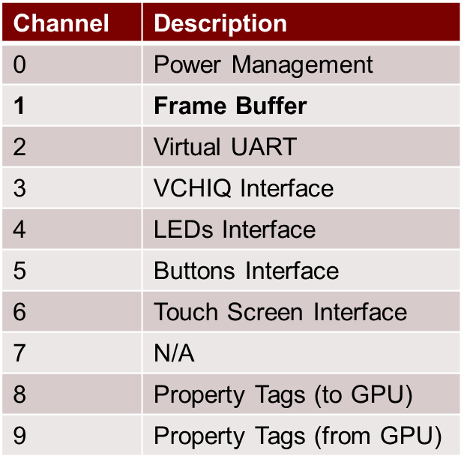
Mailbox 0 Channels

Slide 34
Frame Buffer Interface
Send (write) a message via mailbox 0, channel 8 to initialize frame buffer by GPU
The MS 28 bits of message contain the address of a structure (frameBufferInfo) that contains information about the frame buffer
LS 4 bits contain 8, the channel #
GPU responds with a non-zero message, setting appropriate values in frameBufferInfo

Slide 35
Initializing the Frame Buffer
FBI
Frame
Buffer
Info
Mailbox Write Register
FBI
1000
Core
GPU
Mailbox Read Register
!= 0
1000

Slide 36
The frameBufferInfo Array
Created in RAM
Must be 16-byte aligned
Only the MS 28 bits of the address can be passed through the mailbox
Contains tags
A tag contains a value buffer

Slide 37
Tag Structure
Word 1: Tag identifier
Unique identifier for tag
Word 2: Value buffer size in bytes
Word 3: MSB is request/response bit, remaining bits are value length in bytes
0 = request; 1 = response
Buffer value

Slide 38
Example Tag
.int 0x00048003 // Tag ID
//Set Physical Display width and height
.int 8 //size of buffer
.int 8 //length of value
.int 1024 //horizontal resolution
.int 768 //vertical resolution
Tag
Buffer value
MSB = 0 => request

Slide 39
.align 4
frameBufferInfo:
.int 22 * 4 //Buffer size in bytes
.int 0 //Indicates a request to GPU
.int 0x00048003 //Set Physical Display width and height
.int 8 //size of buffer
.int 8 //length of value
.int 1024 //horizontal resolution
.int 768 //vertical resolution
.int 0x00048004 //Set Virtual Display width and height
.int 8 //size of buffer
.int 8 //length of value
.int 1024 //same as physical display width and height
.int 768
.int 0x00048005 //Set bits per pixel
.int 4 //size of value buffer
.int 4 //length of value
.int 16 //bits per pixel value
.int 0x00040001 //Allocate framebuffer
.int 8 //size of value buffer
.int 8 //length of value
FrameBuffer:
.int 0 //value will be set to framebuffer pointer
.int 0 //value will be set to framebuffer size
.int 0 //end tag, indicates the end of the buffer

Slide 40
Frame Buffer Interface
3. Address of
frameBufferInfo
1. frameBufferInfo
Mailbox 0
Channel 8
4. Initialize FB
5. Set FBP, FBS, & pitch
in frameBuffer Info
2. Address of
frameBufferInfo
6. Non-zero message
7. Non-zero message
8. Use FB if FBP !=0
GPU (VC)
ARM core

Slide 41
Frame Buffer Interface (again)
Initialize frameBufferInfo structure
msg[0..3] = 8; msg[4..31] = frameBufferInfo
msg[30] = 1 (forces GPU to not cache FBI!)
Write msg to mailbox(0)
Read msg from mailbox(0)
If msg == 0, return (FB cannot be initialized)
Else
FBP = [frameBuffer]
FBS = [frameBuffer]

Slide 42
Virtual Frame Buffer
This is only used for debugging the frame buffer subsystem
It is a frame buffer that is created in RAM, rather than VRAM
Writing to the virtual FB will not be visible
Useful for systems that do not have a graphics display (embedded systems)

Slide 43
Frame Buffer Architecture
Section 4

Slide 44
Section 4 Objectives At the end of this section you will
Work with the video frame buffer
Understand color resolutions
Calculate the effective address of a pixel

Slide 45
Video frame buffer

Slide 46
Frame Buffer Architecture
Frame buffer:
An array in memory (GPU RAM), where each element represents a pixel on the display
The entire array represents one complete frame (screen)
The 2D frame is mapped to the 1D buffer
e.g. VGA is 640 x 480
Maps to a 1D array with 307,200 elements

Slide 47
Example Resolutions
Standard | Size | Aspect Ratio
VGA | 640 x 480 | 4:3
SVGA | 800 x 600 | 4:3
XGA | 1024 x 768 | 4:3
SXGA | 1280 x 1024 | 5:4
UXGA | 1600 x 1200 | 4:3

Slide 48
Frame Buffer Architecture
Each element in the frame buffer represents the pixel’s color
Size in bits per pixel (bpp) Gives 2^{bbp} colors
Row major organization

Slide 49
Common Graphics Formats
Color depths:
1-bit
monochrome
4-bit
16 fixed colors
8-bit indexed
Choice of 256 colors from a palette
16-bit highcolor
65,536 colors
5 bits for R, B; 6 bits for G
24-bit truecolor
16,777,216 colors
8 bits each for R, G, and B
32-bit RGBA
Like truecolor

Slide 50
Higher Resolution
Higher resolution and/or color depth requires a larger frame buffer
Practical now since RAM is cheap

Slide 51
Drawing a Pixel
To draw a single pixel, set its value in the frame buffer
Must map from 2D logical space to 1D physical RAM
Must know width and height for particular resolution
Use formula: element offset = (y * width) + x
x, y are pixel’s coordinates
Origin is upper left-hand corner
x range: 0 to width-1
y range: 0 to height-1
physical offset = element offset * element size in bytes

Slide 52
Alternatively
To draw a single pixel, set its value in the frame buffer
Must map from 2D logical space to 1D physical RAM
Must know pitch and element size for particular resolution
Use formula: row offset = y * pitch
x, y are pixel’s coordinates
Origin is upper left-hand corner
x range: 0 to width-1
y range: 0 to height-1
pitch is number of bytes in row
not necessarily equal to number of elements * size!
physical offset = row offset + x*element size (bytes)

Slide 53
Drawing a Pixel
pixel
Monitor
Video RAM

Slide 54
Drawing a Pixel
pixel
0xFF
Monitor
Video RAM

Slide 55
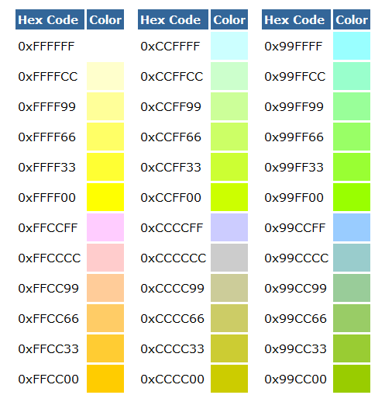
Color Codes
Refer to: http://www.nthelp.com/colorcodes.htm

Slide 56
Frame Buffer Coordinates
x
XGA
1024x768
(0,0)
(1023,767)
y

Slide 57
Examples
E.g. XGA (1 byte per pixel, 8-bit indexed)
element offset = (y * width) + x
Pixel (0,0)
[(0 * 1024) + 0] * 1 = 0
Pixel (1023, 767) (lower right-hand corner)
[(767 * 1024) + 1023] * 1 = 786431

